Slide 1

Artificial Intelligence in HealthCare
Class: ITAI 2372
Presented by: Hashim Sayed Hoosini. Jonathan Cruz, Michael Garcia 06/08/2025

Slide 2
Agenda
Introduction
Domain Overview & Importance
AI Use Case Motivation
AI Techniques used
Key applications (case studies)
Impact & benefits
Challenges & Risks
Future Directions
Final tips & takeaways
Interactive Slide
Conclusion
References & Acknowledgments

Slide 3

-AI Healthcare - Prevention, diagnosis, treatment, and care - Key issues: Rising costs, medical errors, access delays - AI can enhance efficiency and accuracy.
- AI help speeds up the process for medical breakthroughs - Global spending on health is expected to reach $18T by 2040
Domain Overview & Importance

Slide 4

AI Use Case Motivation
- Problem: Delayed or inaccurate diagnosis
- Use Case: Predicting heart disease from EHRs
- Real-World Example: Google’s AI predicts cardiovascular risk using eye scans

Slide 5
AI Techniques Used
Algorithm
Experimental
- CNNs for image analysis in radiology (e.g., X-rays)
- NLP for processing doctors' notes and EHRs
- Machine Learning for prediction models
- Reinforcement Learning for robotic surgery
-Machine learning to help with the creation of stable algorithms
Data

Slide 6

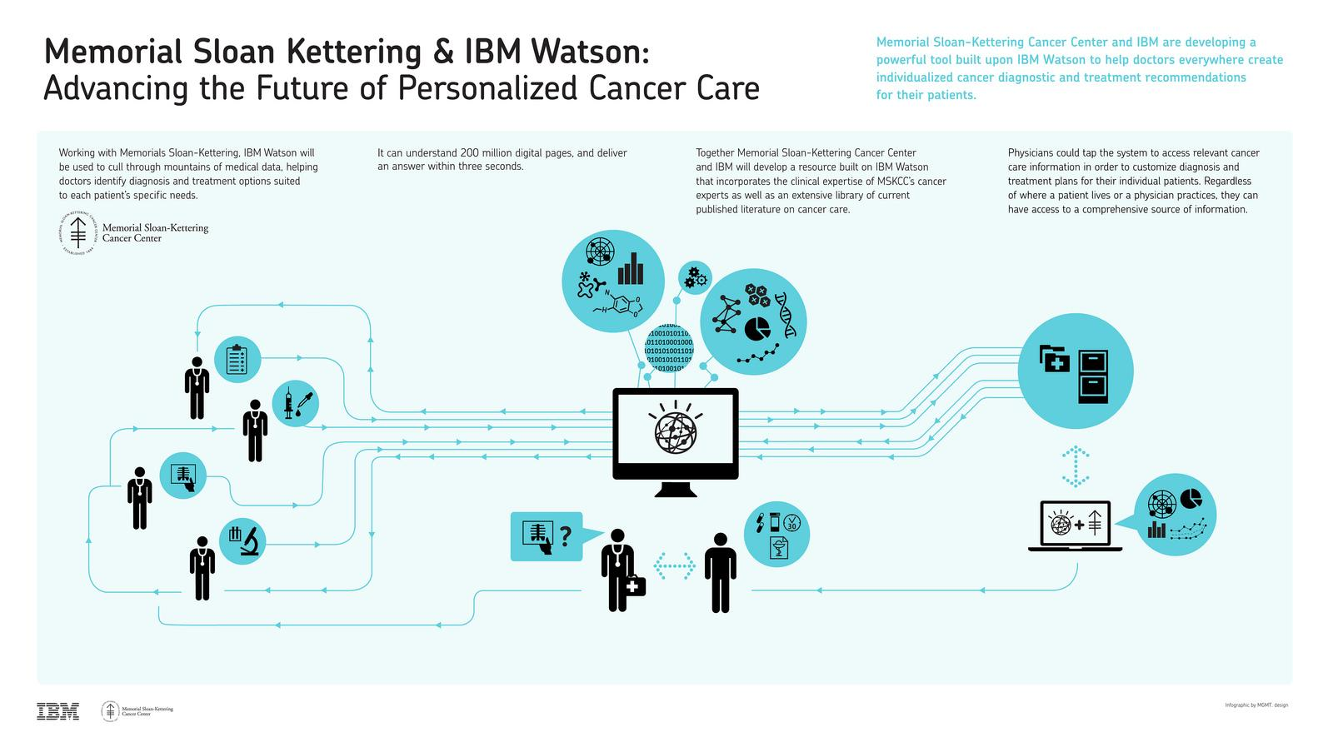
Key Applications (Case Studies)
-IBM Watson for Oncology: AI recommends cancer treatments
- Google DeepMind: Diagnoses eye disease with 94% accuracy
- Ai doc AI: Used in ERs for fast stroke detection from CT scans
-gRED & NVIDIA Bio NeMo for algorithm synthesis which helps in creating unique cancer vaccines for patients.

Slide 7
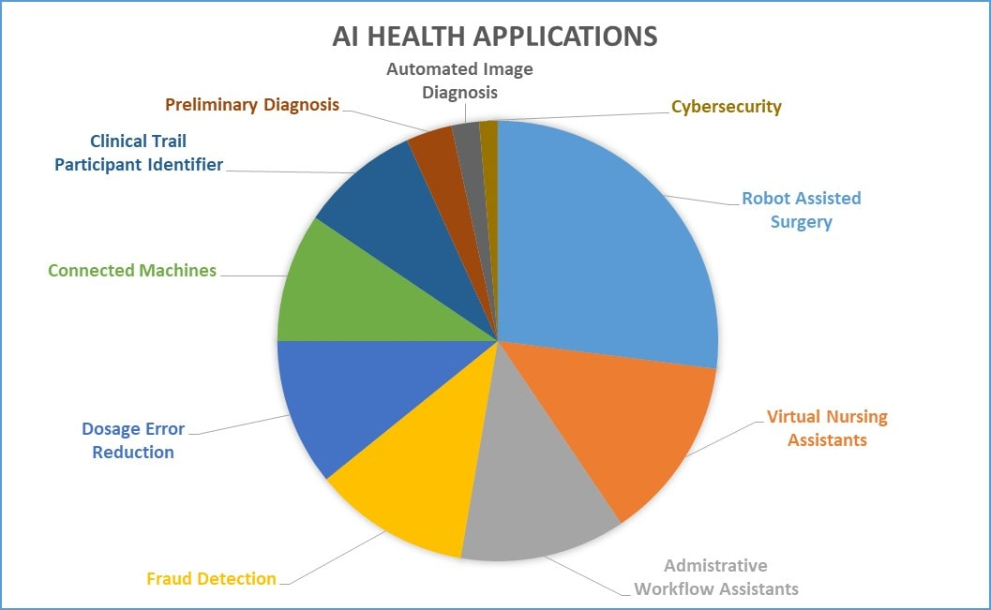
Impact & Benefits
- Improved accuracy in diagnostics (↓ human error)
- Faster results (minutes vs. hours) = less time needed to develop new medicine
- Lower costs (fewer unnecessary tests)
- Better patient outcomes (early treatment = higher survival)

Slide 8

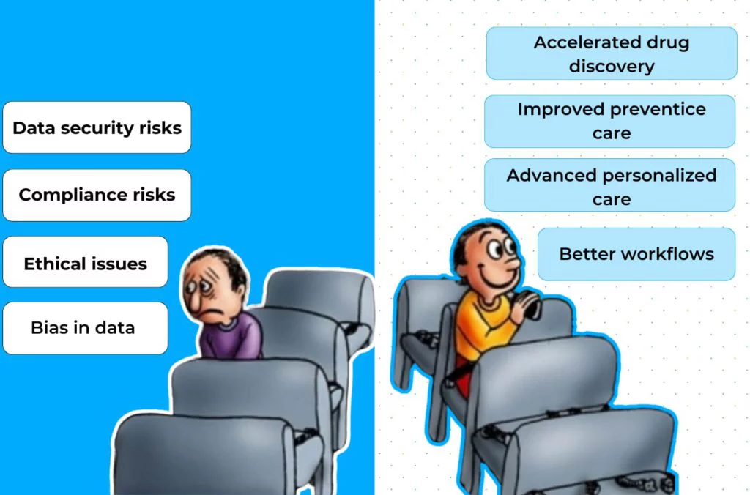
Challenges & Risks
- Data Privacy: Medical data is sensitive
- Bias in Training Data: Can affect minorities
- Regulations: AI tools need FDA/EMEA approval
- Model Explainability: Doctors must understand AI decisions

Slide 9
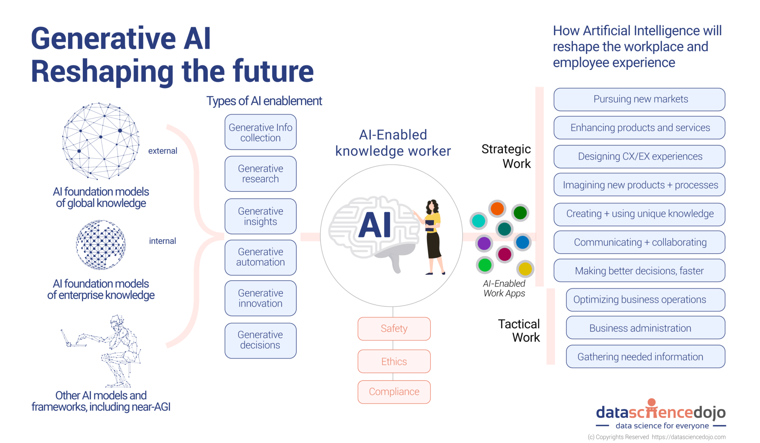
Future Directions
Multimodal AI: Text + image + audio = richer understanding
- Federated Learning: Secure training across hospitals
- Explainable AI (XAI): Improves trust
- Wearables + AI: Real-time health monitoring
- Generative AI in medicine = higher level of advanced medical technology

Slide 10
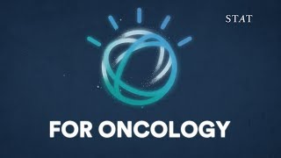
Interactive Slide
How does Watson for oncology work?
Stat, 2017

Slide 11
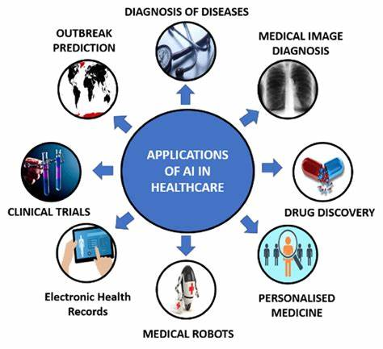
Conclusion
- AI improves speed, accuracy, and access to care
- Supports doctors—not replaces them
- Helps make healthcare smarter and more equitable
- AI helps with the discovery of new medical technology

Slide 12
Q&A sessions
Questions?

Slide 13
References & Acknowledgments
Bajwa, Junaid, et al. (2021). Artificial Intelligence in Healthcare. Future Healthcare Journal.
“Genentech: Press Releases: Tuesday, Nov 21, 2023.” Genentech: Press Releases | Tuesday, Nov 21, 2023, Genentech, 21 Nov. 2023, www.gene.com/media/press-releases/15010/2023-11-21/genentech-and-nvidia-enter-into-strategi?_gl=1%2A1u9l390%2A_ga%2ANDUyMDg2NjU2LjE3NDk0MzYxMTI.%2A_ga_QG6V0C1ZQF%2AczE3NDk0MzYxMTEkbzEkZzAkdDE3NDk0MzYxMTEkajYwJGwwJGgw&_ga=2.42512291.764653188.1749436112-452086656.1749436112&_gac=1.39315952.1749436112.b0d8cac93e5010282ecda28f789b3b56.
“How AI Is Being Used to Benefit Your Healthcare.” Cleveland Clinic, Cleveland Clinic, 5 Sept. 2024, health.clevelandclinic.org/ai-in-healthcare.
“How Does Watson for Oncology Work?” YouTube, STAT, 6 Sept. 2017, www.youtube.com/watch?v=UpFHNGF4F8o&t=18s.
“Redefining Drug Discovery with Ai.” Genentech: Breakthrough Science. One Moment, One Day, One Person at a Time., Genentech, 18 Mar. 2024, www.gene.com/stories/redefining-drug-discovery-with-ai.
WHO (2021). Ethics and governance of AI for health
Xie, Zhai, Lu (2025). Evolution of AI in Healthcare: Google Health & IBM Watson websites

Slide 14

Thank you
Hashim Sayed Hoosini, Jonathan Cruz, Michael Garcia
ITAI 2372 class presentation

